Slide 1
Submarine Fan
Petroleum system implications

Slide 2
Data sources for geologists
Well logs
Core data
Seismic
Analogues (outcrops)
!! They integrate all the data available in order to have a proper reservoir characterization.

Slide 3
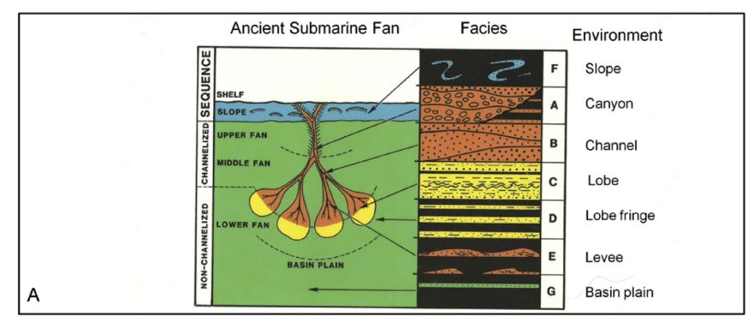

Classic Submarine Fan

Slide 4
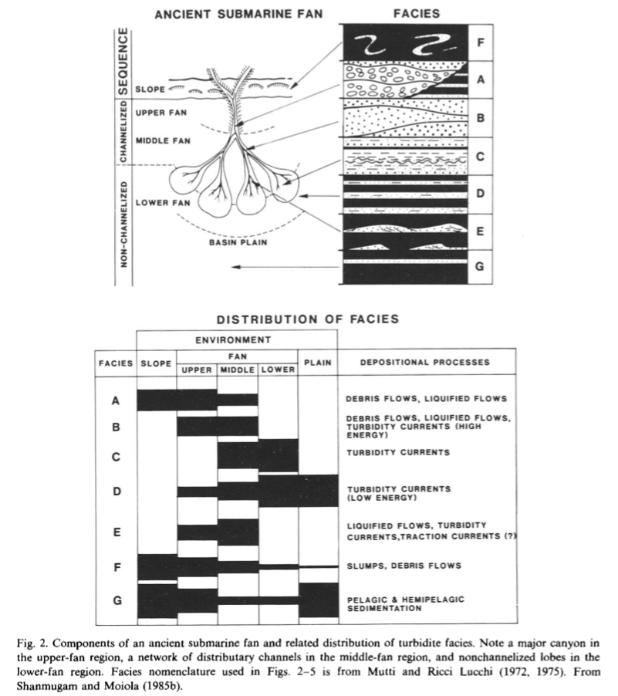

Slide 5
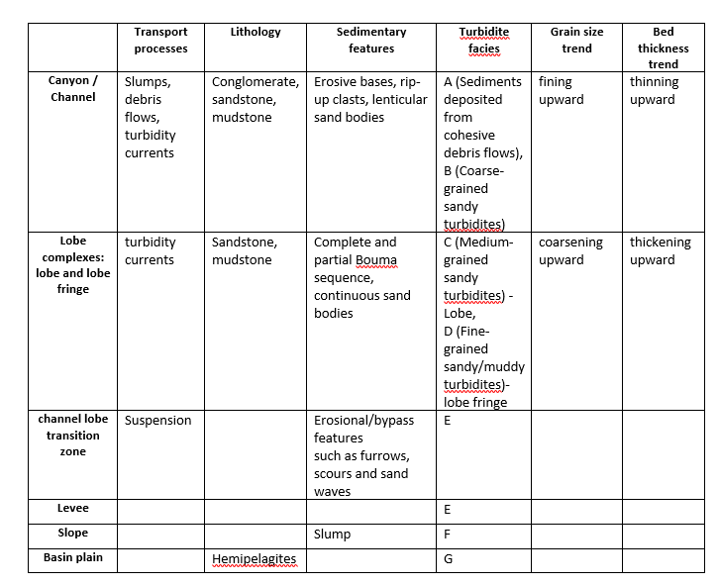
Submarine Fan
On well logs

Slide 6
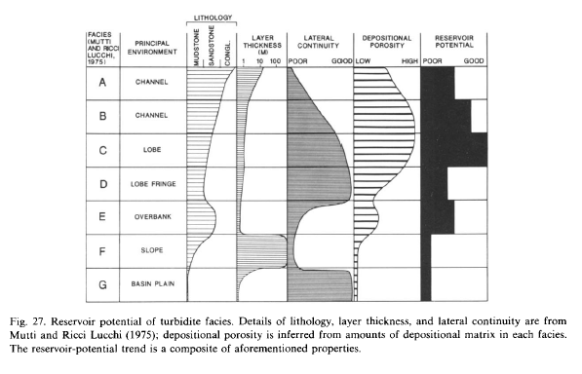
Reservoir potential based on facies

Slide 7
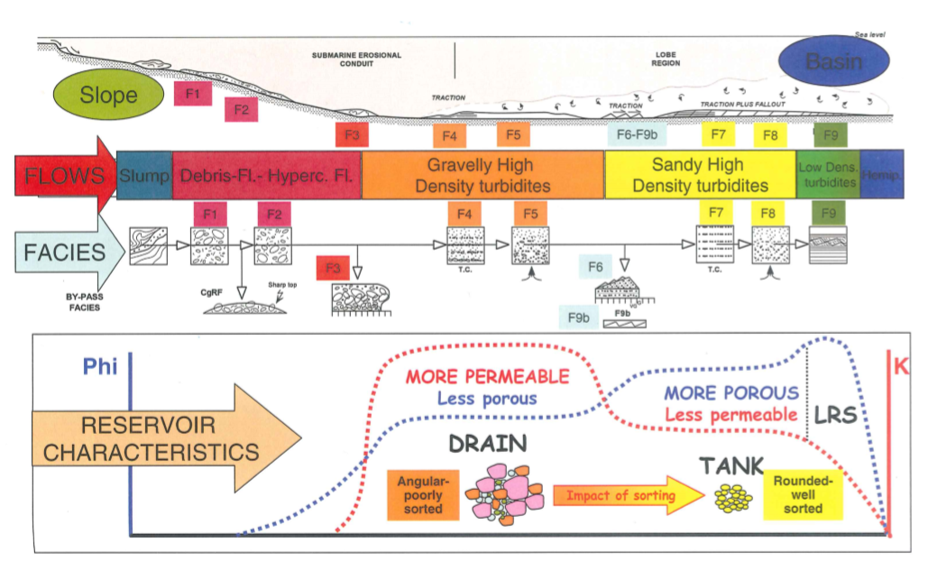
Mutti’s facies classification and reservoir potential

Slide 8
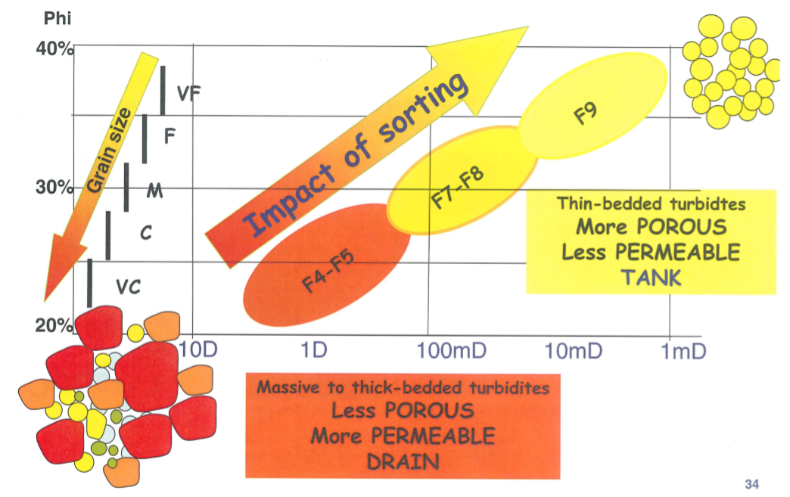
Mutti’s facies classification and reservoir potential

Slide 9
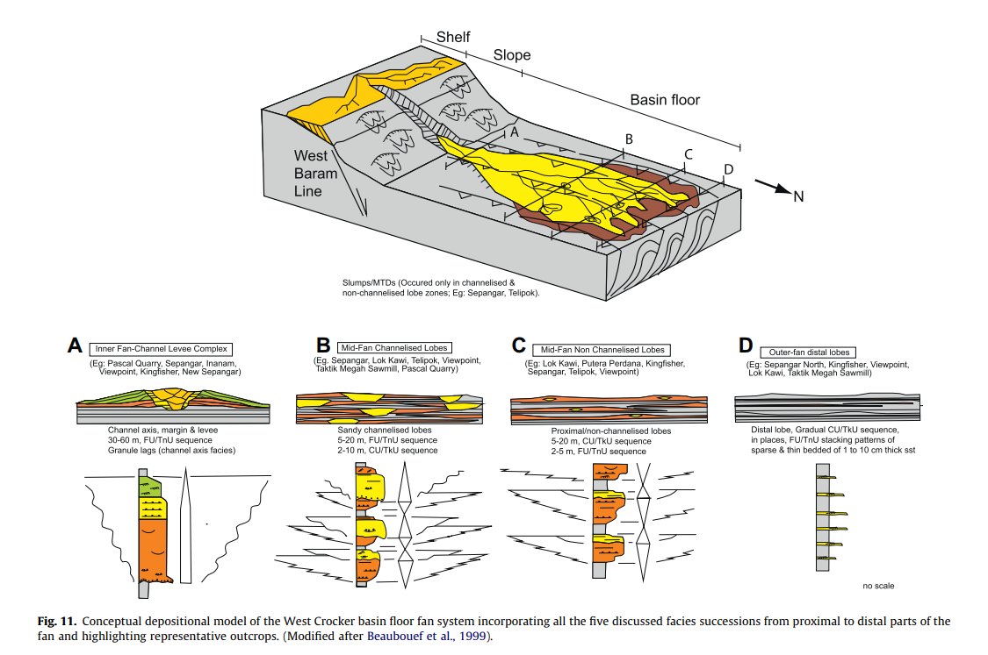

Slide 10
Prolog examples:
/*DepositionalPorosity classiffication*/
%veryGoodPorosity(facies(c), lobe).
%goodPorosity(facies(b), ch2).
%moderatePorosity(facies([a,d]), [ch1,lobeFringe]).
%lowPorosity(facies(g), basinPlain).
/*LateralContinuity*/
goodlateralContinuity(facies(g), basinPlain).
goodLateralContinuity(facies([d,c]), [lobeFringe, lobe]).
moderateLateralContinuity(facies(b), ch2).
poorLateralContinuity(facies(a), ch1).
poorLateralContinuity(facies(e), overbank).
/*PermeabilityClassiffication*/
%goodPermeability(facies(c), lobe).
%goodPermeability(facies(b), ch2).
%veryGoodPermeability(facies(a), ch1).
%moderatePermeability(facies(d), lobeFringe).
%lowPermeability(facies(g), basinPlain).

Slide 11
Prolog examples:
/*ReservoirPotential*/
reservoir_has(r1,lobe).
reservoir_has(r1,ch2).
reservoir_has(r2,lobeFringe).
reservoir_potential(R,very_good) :- reservoir_has(R,lobe).
reservoir_potential(R,good) :- reservoir_has(R,ch2).
reservoir_potential(R,moderate) :-
( reservoir_has(R,ch2) ; % "or" ("," in case of "and")
reservoir_has(R,lobeFringe) ).
reservoir_potential(R,minimum) :- reservoir_has(R,basinPlain).

Slide 12
Facies classification and characterization (Mutti and Ricci Lucchi, 1972,1975)
Facies A –
conglomerate, course-grained pebbly sandstones, pebbly mudstone
Bed thickness > 1m, but frequent lateral variation in thickness
Scour and channeling are common
Most commonly associated with facies B and E
Individual flow units can be identified
Occurs in upper and middle fan
Moderate reservoir potential because of abundant depositional matrix
Facies B –
course – to medium- grained sandstones, in thick, massive and often composite bed sequences
lateral bed continuity is better than facies A
occurs in channelized settings, particularly in upper and middle fans
Better reservoir than facies A, are better sorted and more continuous
High-density turbidity current
Facies C –
Course- to fine-grained sandstone, commonly interbedded with thin layers of mudstones
Sandstone beds represent the classical turbidite of Bouma sequence
Sandstone beds have thickness of 0,25 – 2, 5 m, and have uniform thickness for great lateral extent
Normal grading is common
Associated with the upper part of the channel fill sequences, and in non-channelized settings like middle fan and lower fan.
Best potential for reservoir development (having high depositional porosity)
High-density turbidity current

Slide 13
Facies classification and characterization
Facies D –
Thin interbedded sandstones and mudstones
Great lateral extent
Each sandstone bed is normal graded and represent the upper part of the Bouma sequence (Tcde or Tce).
Occurs in all parts of a submarine fan
Moderate reservoir potential
High-density turbidity current
Facies E –
Thin interbedded sandstones and mudstones
Ripple laminated and lenticular sandstones
Sandstones are courser than in facies D with the same thickness
Higher sand/shale ratio than facies D
Thinner but numerous sandstones beds than facies D
Associated with channelized settings
Facies B/E are specific for upper and middle fan
Facies E with D, G and F are specific for overbanks and levee deposits
Slightly better reservoir potential than facies D
Low-density turbidity current
Facies F –
Remobilized deposits showing mass slumping
Typically found near the lower slope or along channel margin in upper and middle fan
Minimum potential for reservoir development
Facies G –
Pelagic and hemipelagi
Best developed in interchannel settings
Minimum potential for reservoir development
Low-density turbidity current

Slide 14
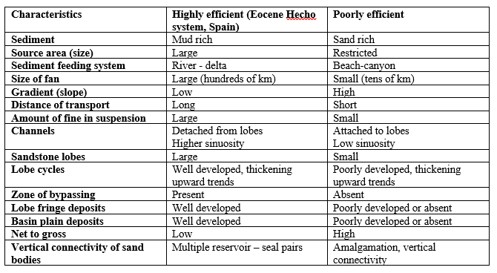
Types of Submarine Fan system
Based on efficiency to transport sand, there are 2 types of fan system:
Highly efficient
Turbidity currents of a mud-rich system transport sand efficiently over long distances
Poorly efficient
The transport efficiency of a sand-rich system is relatively poor

Slide 15
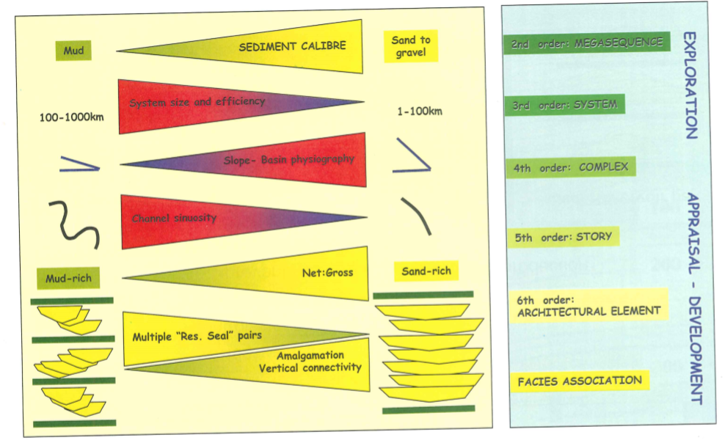
Types of Submarine Fan system

Slide 16
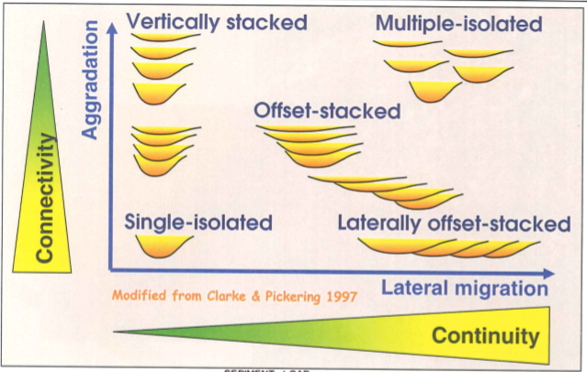
Geometry of turbidite channels

Slide 17
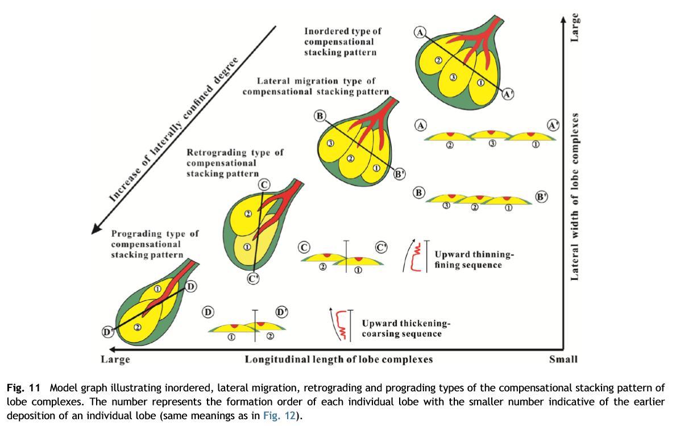

Slide 18
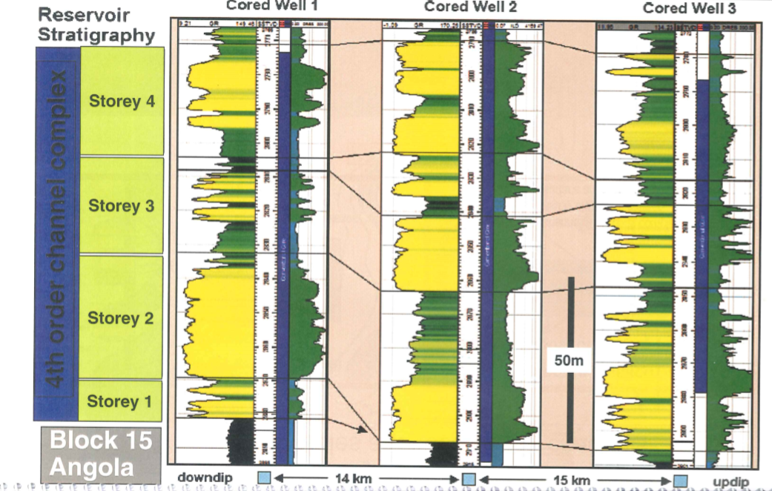
Well logs - multy storey channel

Slide 19
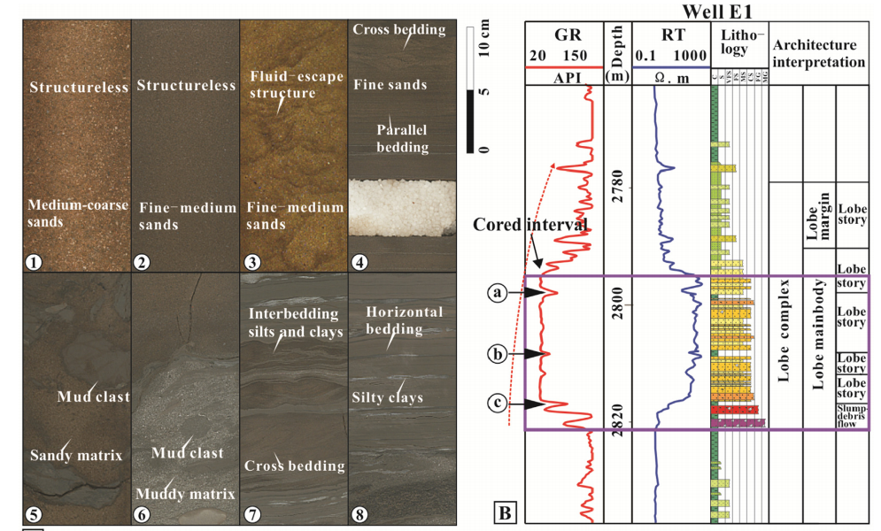
Lobe complex

Slide 20
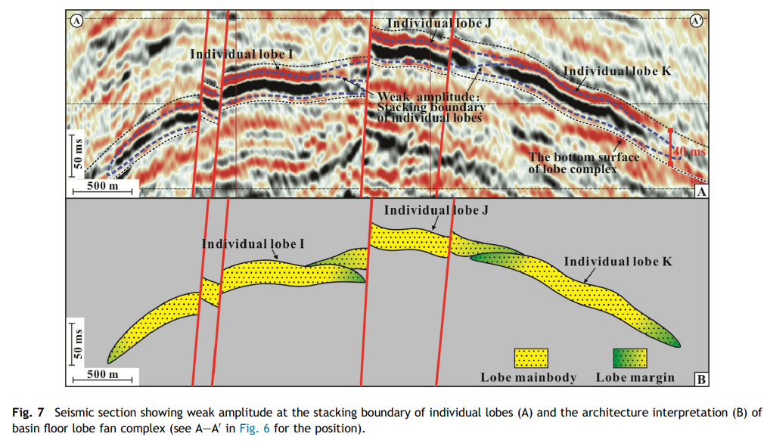
Lobes on seismic

Slide 21
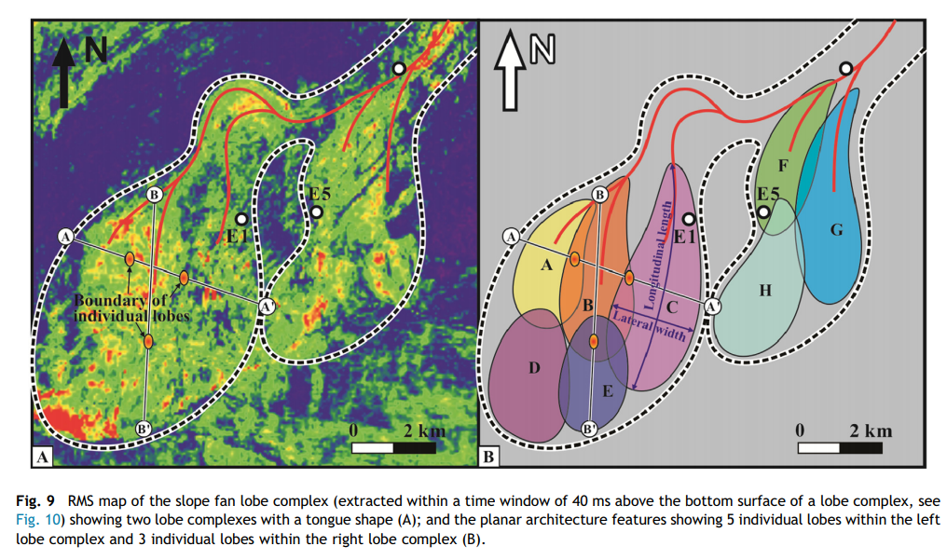
Lobes on seismic attributes

Slide 22
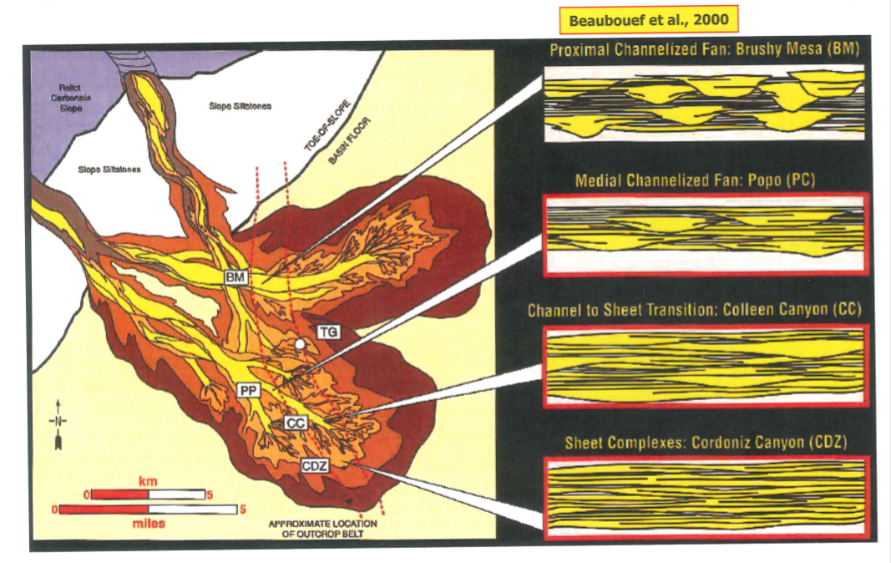
Depositional model and reservoir architecture

Slide 23
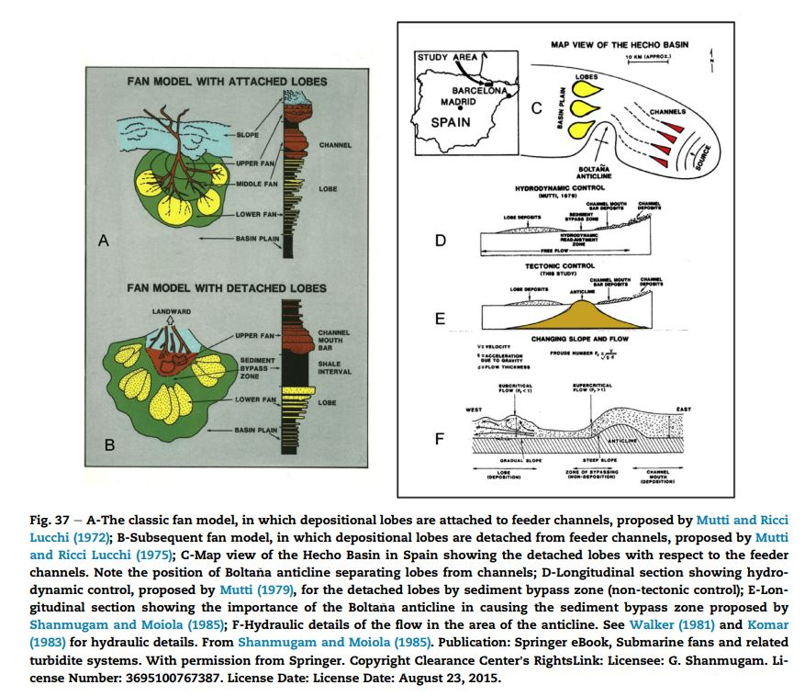
Classical Fan model, Mutti and Ricci Lucchi, 1972

Slide 24
